Slide 1
File Formats in Hive
Notes:
Hi and Welcome back

Slide 2
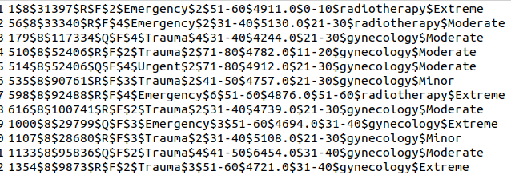
File Formats in Hive
Notes:
So far we have stored data in Hive tables in simple text format. Such a format is very useful for viewing or editing the files manually. But since we are dealing with large sets of data in Hive, this probably is not the most efficient format to store the data because…

Slide 3

File Formats in Hive
Disk Utilization
I/O Performance
Notes:
we need better disk utilization and…
<<click>>
better input output performance.

Slide 4
File Formats in Hive
ORC
SequenceFile
Parquet
Notes:
Hive supports various file formats like ORC, sequence file, Parquet, etc.
But probably the most popular one is…
<<click>>
ORC. So let’s look at what’s so special about the ORC file format.

Slide 5
ORC File Format
Optimized Row Columnar
Binary format
Compressed columnar format
Notes:
So…
<<click>>
ORC or Optimised Row Columnar is a…
<<click>>
binary format of storing data.
<<click>>
It stores data in a compressed columnar format which makes it suitable for querying regularly on the columns rather than on the rows. Let me show you what is meant by columnar format.

Slide 6
ORC File Format
Id | Name | Department | Salary
AV003 | Jack | Technology | 1000
AV053 | Samantha | Admin | 1200
AV062 | Kim | Operations | 900
Notes:
Say we have this sample table in Hive and we want to store it in ORC format in Hive.

Slide 7
ORC File Format
Id | Name | Department | Salary
AV003 | Jack | Technology | 1000
AV053 | Samantha | Admin | 1200
AV062 | Kim | Operations | 900
Notes:
So Hive…
<<click>>
will actually store all the data from a particular column together in the disk.
<<click>>
Similarly it will do that for all the columns in the table. An ORC file structure is a little more complex than this.

Slide 8
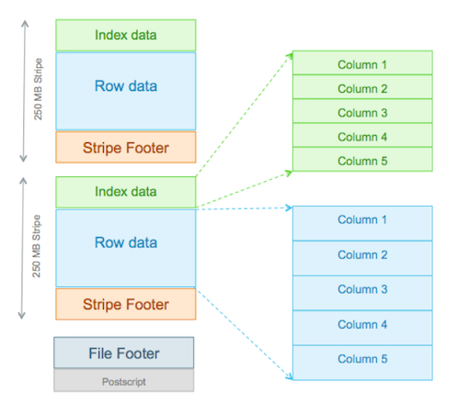
ORC File Format
Notes:
ORC contains groups of row data which are called Stripes. By default they are of 250 MB each. But you can change that as per requirement.
Now, each stripe has…
<<click>>
Index data
<<click>>
Row data
<<click>>
And Stripe Footer

Slide 9
ORC File Format
Notes:
Index data contains the minimum and maximum values for each column as well as the offset for the row data. So it knows where the row data is located within each column. This is very helpful as it allows Hive to entirely skip stripes of rows if certain data isn’t present there.

Slide 10
ORC File Format
Notes:
Then there is the Row data which actually contains the data stored in the rows which are part of this Stripe. And both, the Index and the Row data, are stored in columnar format so it enables efficient querying.

Slide 11
ORC File Format
Notes:
Then we finally have the Stripe footer that contains metadata about the stripe.

Slide 12
Parquet File Format
Columnar storage
Compressed format
Notes:
Now besides the ORC file format, we also have the Parquet format which…
<<click>>
Is also a columnar format and…
<<click>>
Stores data in a compressed format. When comparing ORC and Parquet formats, there isn’t much difference between the two and you will find these two being used commonly in the industry.

Slide 13
SequenceFile Format
Binary key-value pairs
Compressed format
Row level storage
Notes:
However, the SequenceFile format is a bit different.
<<click>>
It also contains data in binary format, albeit in a key-value pair manner…
<<click>>
and stores it in a compressed format, however…
<<click>>
this file format stores data in row-level format unlike the ORC file format. So here, the entire data for a row is stored together and so it is more suitable for row-level querying.

Slide 14
Thank You!
Notes:
That is it with respect to the file formats in hive. Thank you

